Slide 1

Food Delivery
Website and Application

Slide 2

Food Delivery Website and Applications
LMS user
name
Name
Batch
2115a156
2115a149
2115a148
M. Hemanth
Krishna Reddy
A1
Danisetty Sree
Ganesh
A1
Annameti Pavan
Kumar
A1

Slide 3
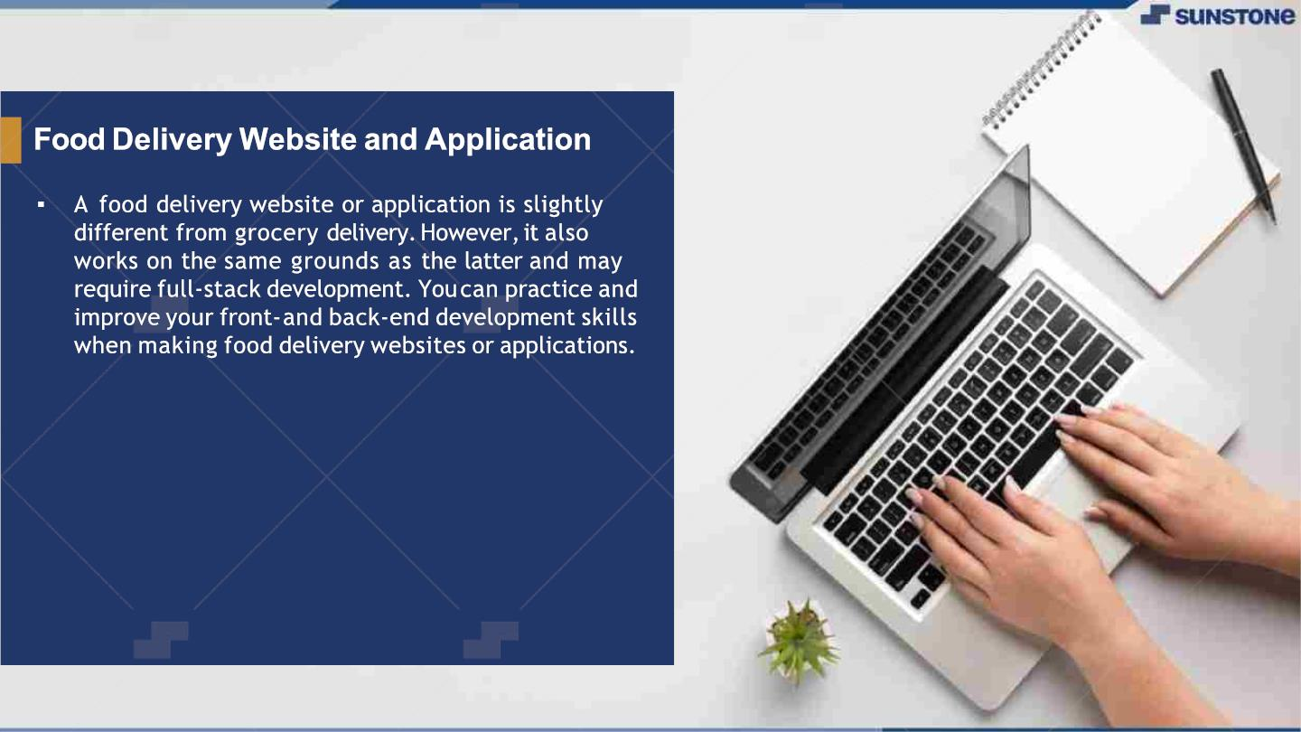

Slide 4
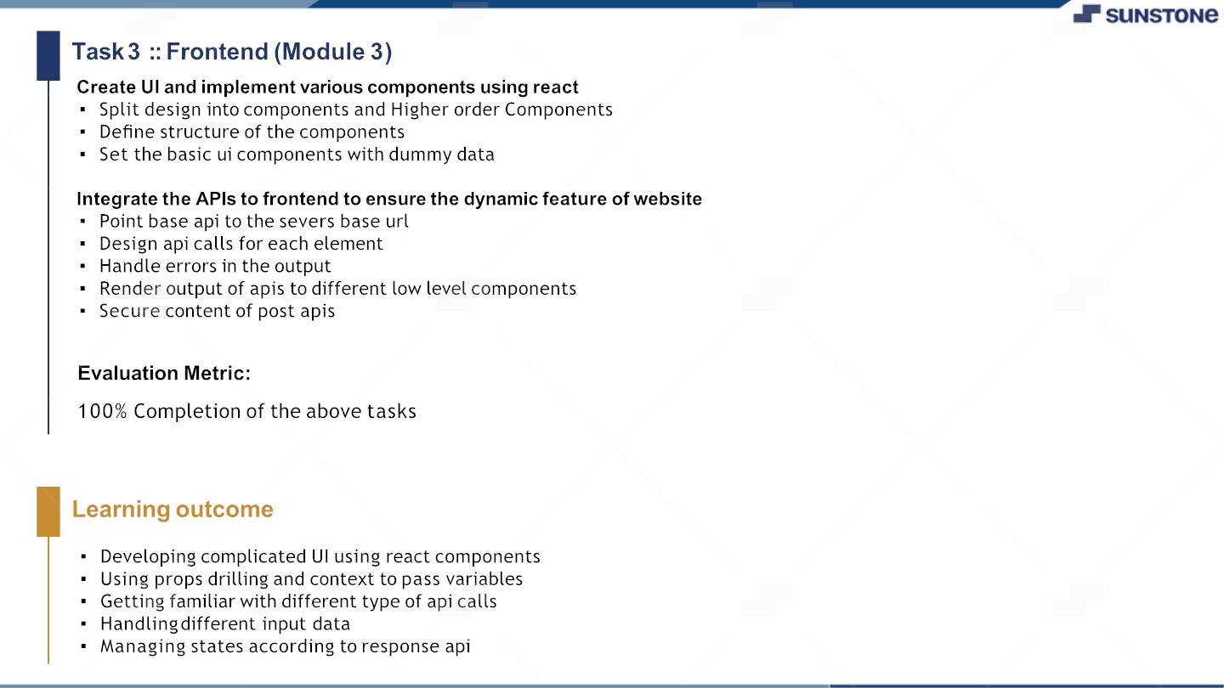

Slide 5
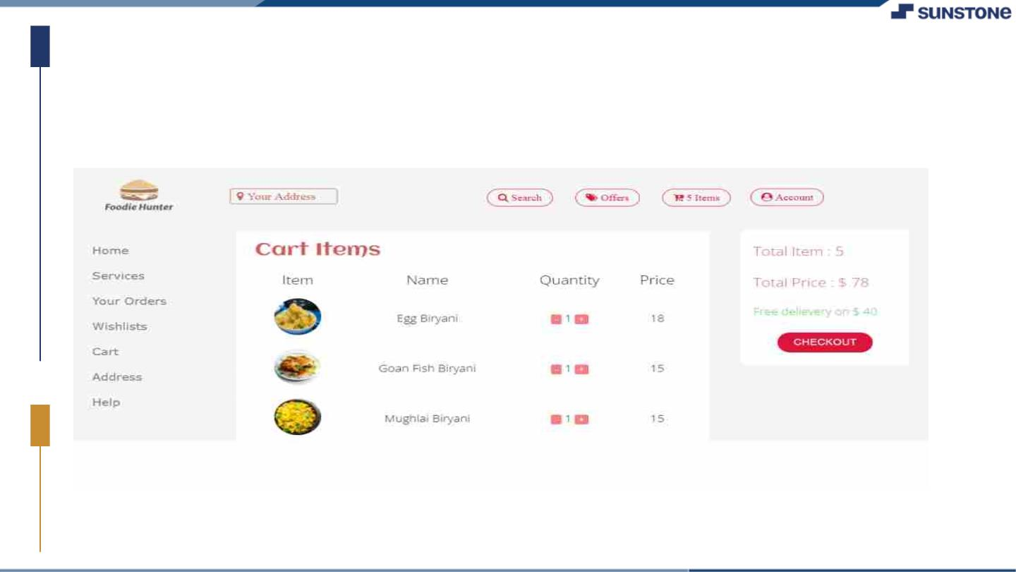
Food Delivery Website and application
Task 3

Slide 6

Food Delivery Website
and Application Hands on
https://github.com/SreeganeshGit8/Sree-Ganesh.git

Slide 7


